Slide 1


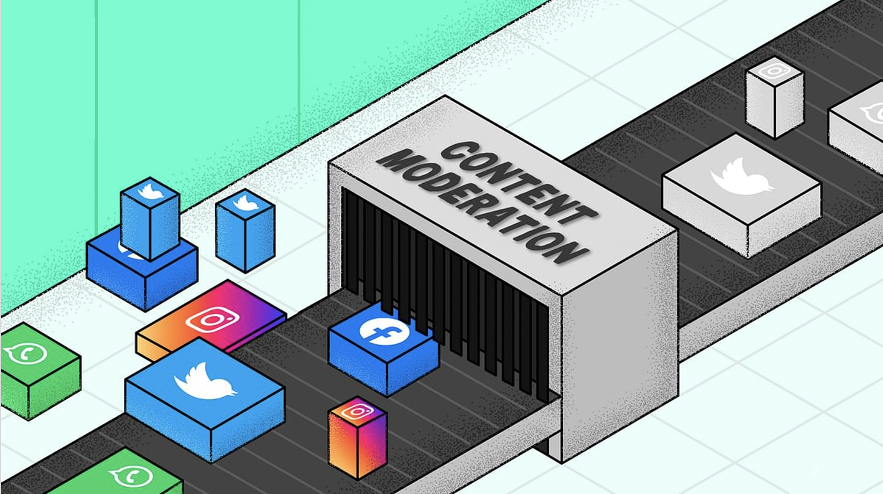
Designing Transparent and Effective Content Moderation
Shagun Jhaver

Slide 2
Will you allow this on your site?
Let’s beat up fat kids
I hope someone kills you
Someone shoot Trump
#stab and become the fear of the Zionist.
Content Moderation
Notes:
Thank you for that Introduction, and thanks for inviting me!
I will start today with a thought exercise.
Let’s suppose that you create a new social media website. What type of comments will you allow on that site?
If someone posts this comment, will you allow it or remove it?
How about this comment?
What if someone posts this?
How about this?
It turns out that making decisions like these about which posts to allow and which to remove is a fundamental service that all social media platforms like Facebook, Twitter and Reddit provide. This service is called content moderation.

Slide 3
Facebook’s internal rulebook for content moderation:
✅
Let’s beat up fat kids
✅
I hope someone kills you
❌
Someone shoot Trump
❌
#stab and become the fear of the Zionist.
Notes:
Now these four comments are actually examples from Facebook’s internal rulebook for content moderation. This rulebook was leaked a while ago, and according to this rulebook, the top 2 comments should be allowed and the bottom 2 comments should be removed. Now this is what Facebook would do, but other platforms may have different criteria for what is appropriate, and they may make different moderation decisions on these comments.
As a researcher, I am interested in examining how social media platforms make these moderation decisions, and how these decisions impact end-users.

Slide 4

Build a foundation for designing
transparent and effective content moderation systems
©Francesco Ungaro
Notes:
The main goal of my research is to

Slide 5

Agenda
Background
Transparency
Effectiveness
Future Work
5
Notes:
Now, here is the agenda for my talk today
I will begin with offering a background on content moderation.
Next, I will describe my research on tranparency in content moderation
Next, I will discuss my work on evaluating the effectiveness of moderation interventions.
Finally, I will conclude with detailing some future directions of my research.

Slide 6
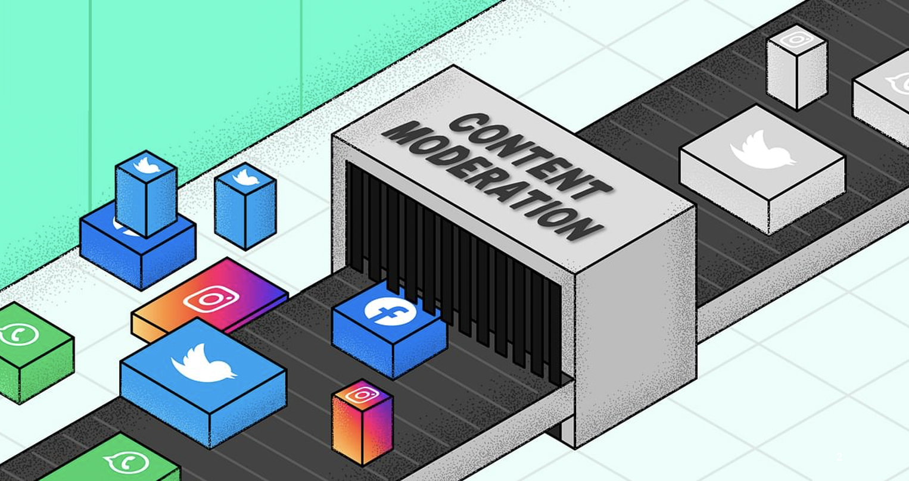
What is content moderation?
Background
Organized practice of screening user-generated content posted to Internet sites in order to determine its appropriateness for that site (Roberts 2017)
A complex sociotechnical system
Admins
Community guidelines
Moderators
Moderation bots
Users
Roberts, Sarah (2017) Content Moderation. Encyclopedia of Big Data.
Notes:
Content moderation is enacted by a rich and complex sociotechnical system.
First, it has a small group of admins. These admins are platform employees who make high-level decisions about how moderation should work.
Then, there are community guidelines which are a set of rules that dictate how users should behave.
Then there are moderators who enforce these community guidelines. These moderators are at the frontline and they make low-level moderation decisions about which posts should be removed or which users should be banned.
These moderators work with a wide variety of automated tools to make their job easier.
Finally, there are end-users who flag content that violates community guidelines, and this flagged content is reviewed by the moderators.
All these different components interact with one another in complicated ways and help constitute content moderation systems.

Slide 7
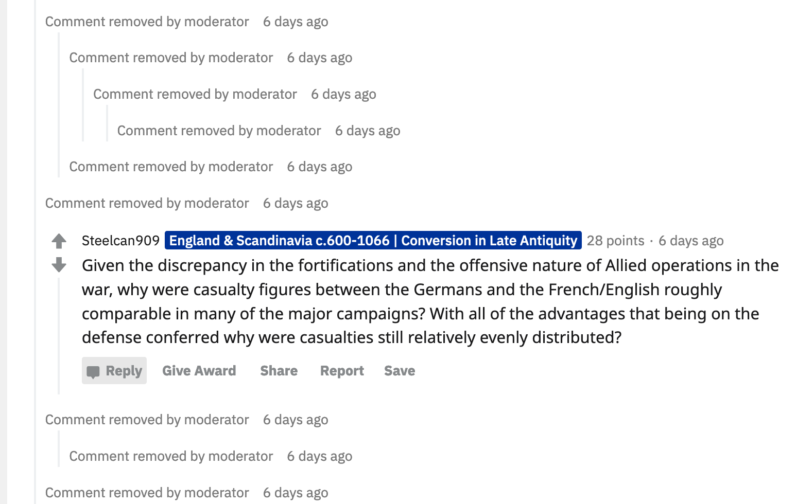
It helps users find relevant information
Background
Notes:
it removes irrelevant comments and makes it easier for the users to find the information they are looking for.

Slide 8
It helps users find relevant information
Background
Notes:
So, content moderation is necessary to ensure that the limited attention of users is not exhausted by unworthy posts.

Slide 9
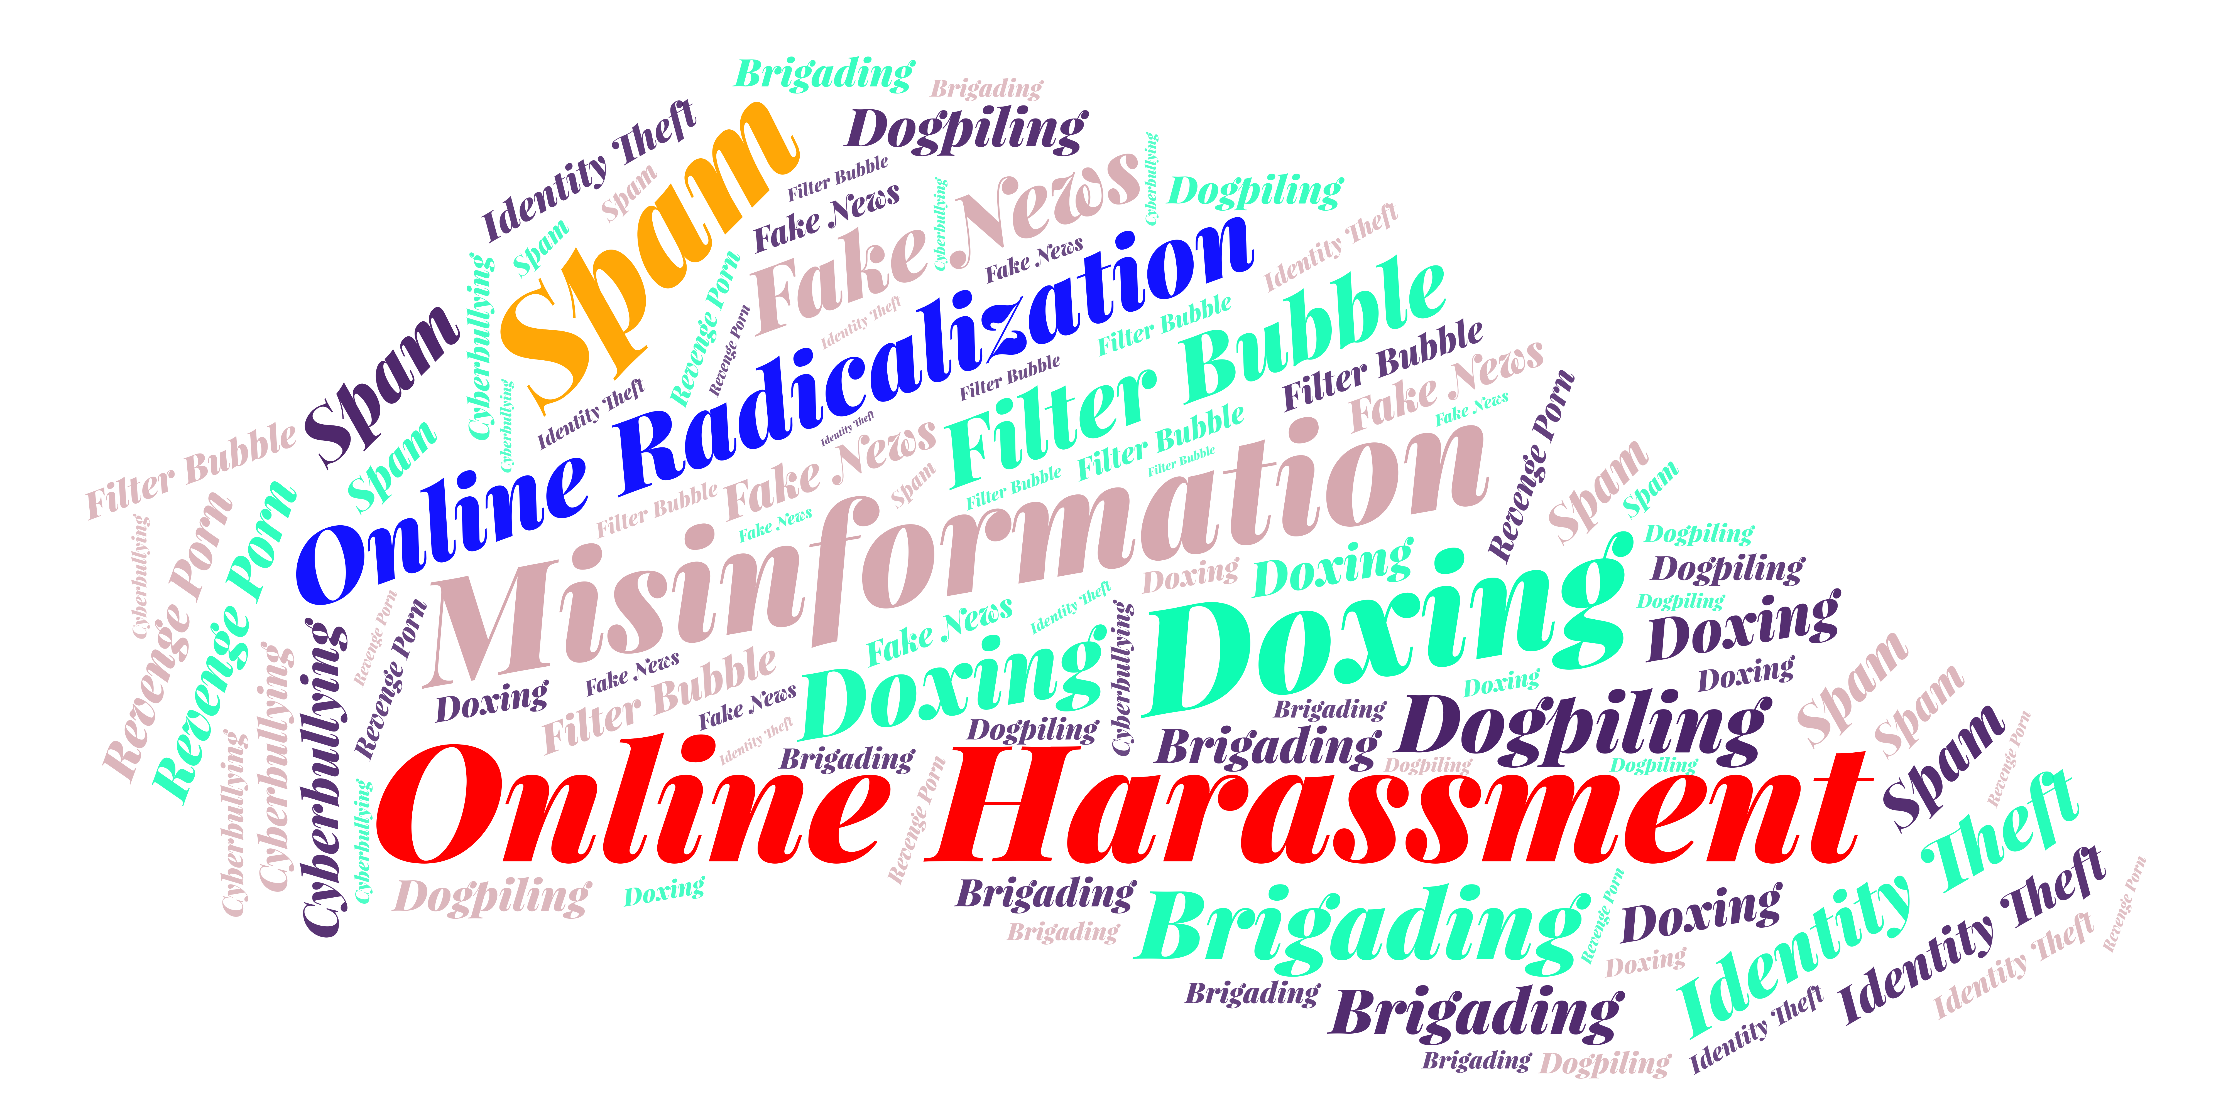
It addresses key problems on the internet
Background
Notes:
Content moderation is responsible for addressing many of the key problems that social media platforms face today.

Slide 10
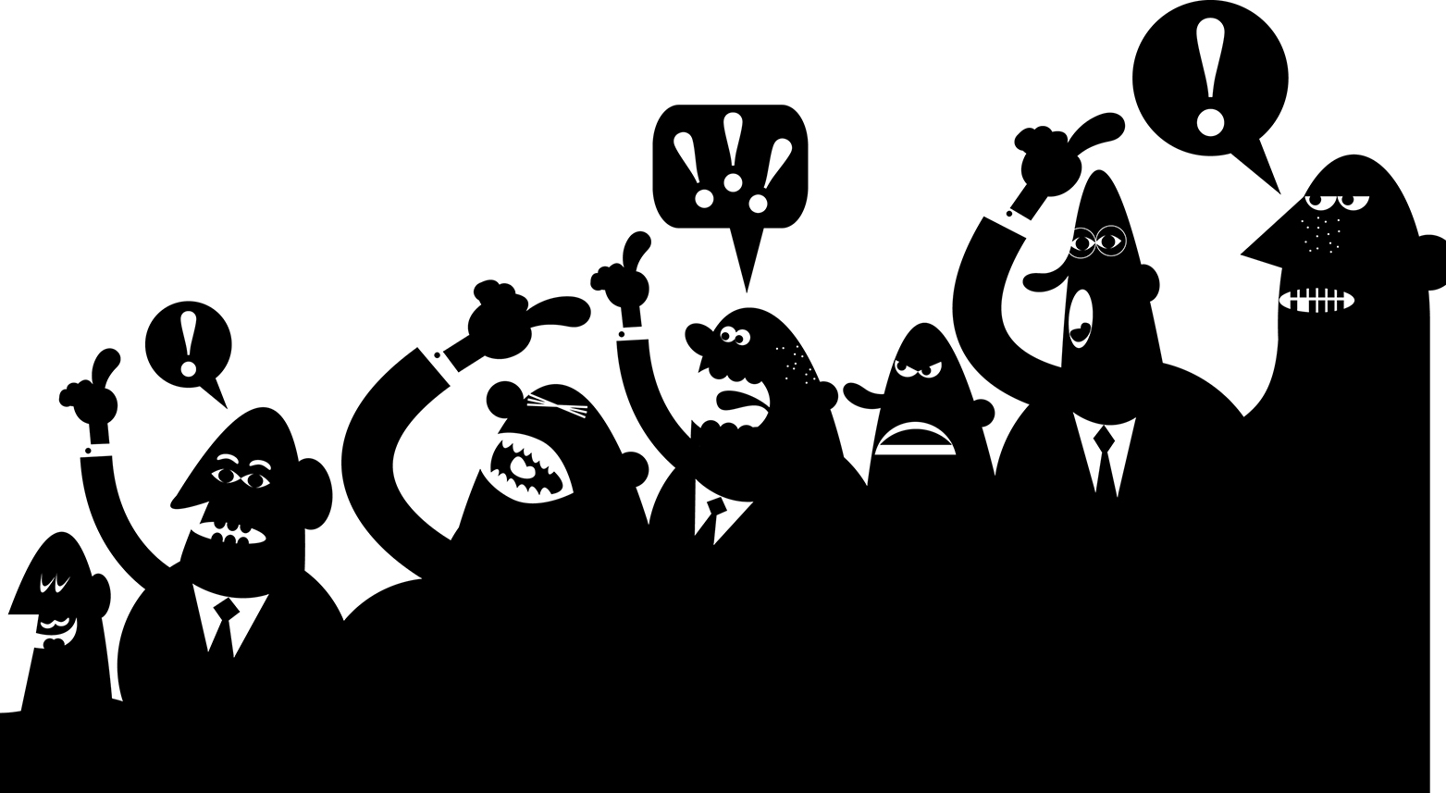
It shapes who gets heard
Background
10
Notes:
At the same time, content moderation is critical to determining which groups’ voices get heard, and whether minorities and other vulnerable groups feel comfortable participating online.

Slide 11
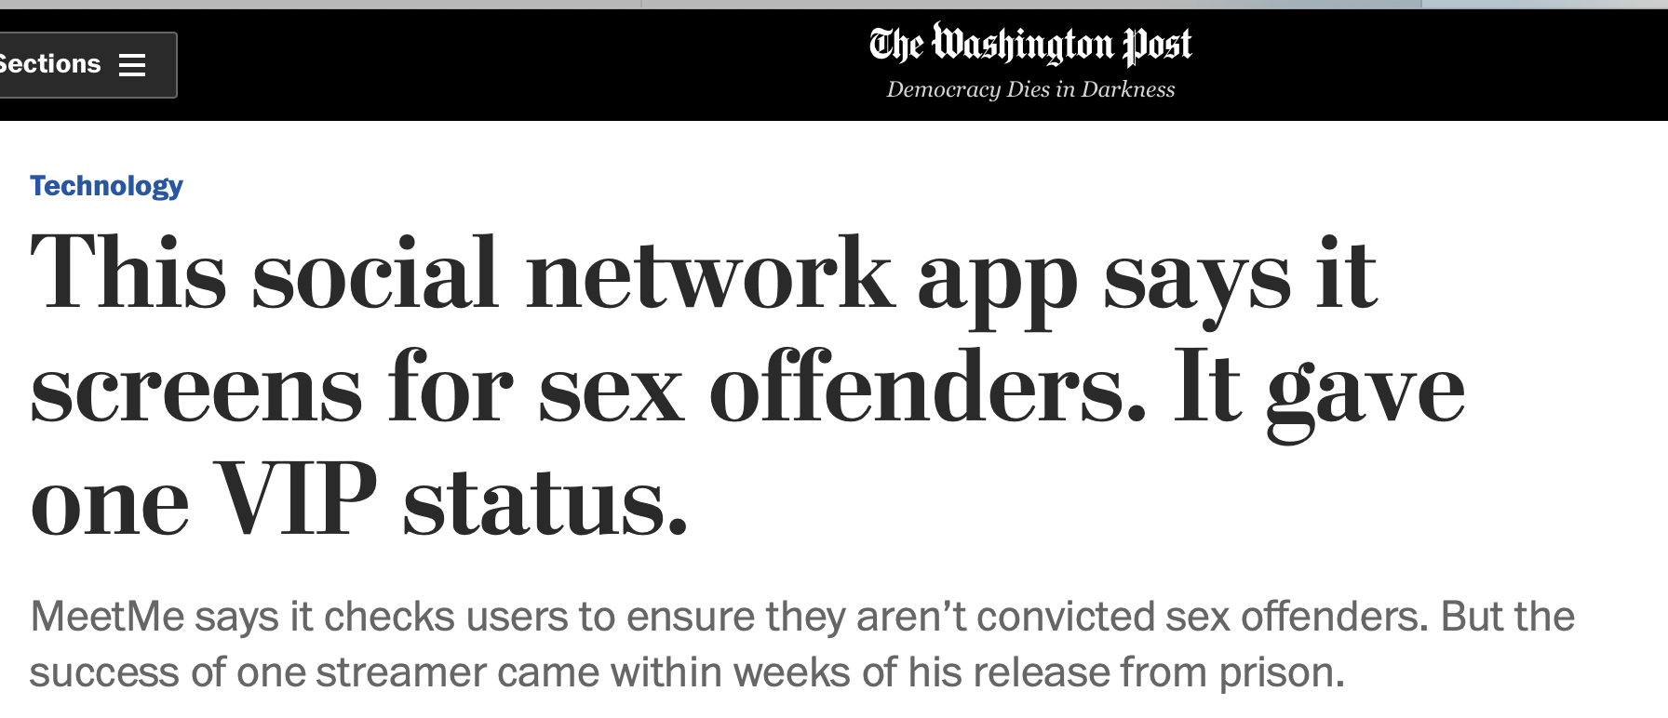
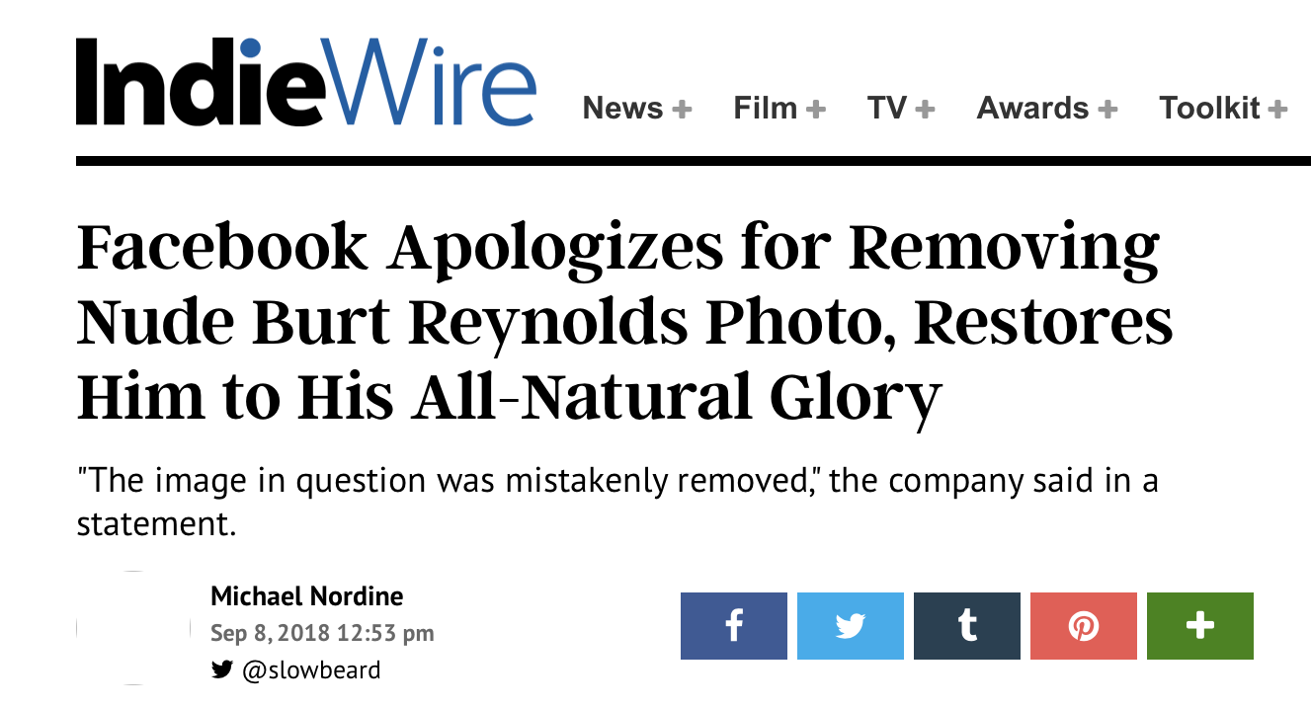
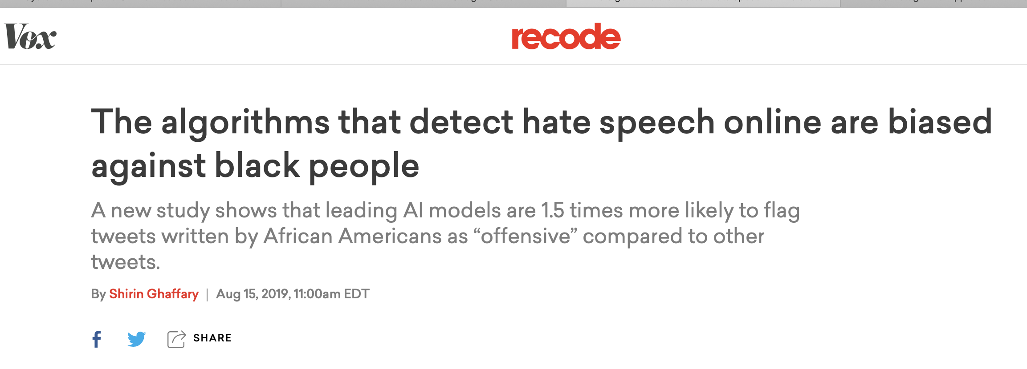
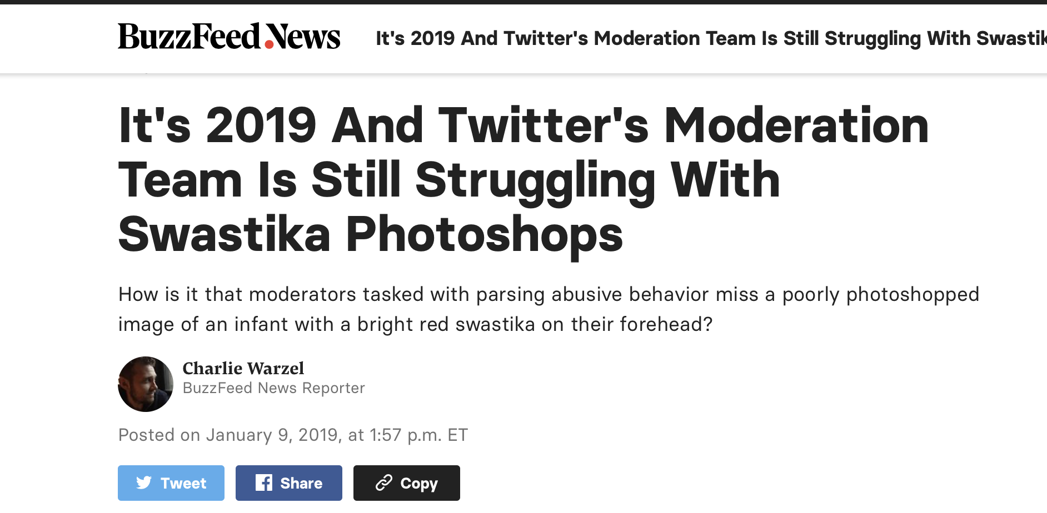
Content moderation is broken
Background
Urgent need to address these failures
Notes:
Unfortunately, content moderation is broken.
It seems like every week, we hear new controversies about how failures in content moderation have resulted in disastrous consequences.
So there is an urgent need for us to address these failures

Slide 12
My approach
Background
Understand moderation needs, perspectives and practices of end-users
Participant observation, surveys, interviews
Building, deploying and testing experimental systems
Study how users behave in response to content moderation
Systematic analyses of platform data
Topic modeling, machine learning, regression analyses, causal experiments
Notes:
systems that explore how different design solutions users.

Slide 13
Background
Social
Computing
Data
Science
Notes:
Although I draw from a wide variety of disciplines, my work largely sits at the intersection of social computing and data science.

Slide 14
Two aspects of content moderation
Background
Transparency
Effectiveness
Transparency in content removals
Current moderation systems are punitive
Little effort in explaining what went wrong
Should moderators provide transparency?
Effectiveness in addressing the rise of online hate groups
Platforms use a variety of approaches
How can we evaluate the effectiveness of moderation approaches?
Notes:
The focus is usually on punishing the offender and little effort is ex

Slide 15


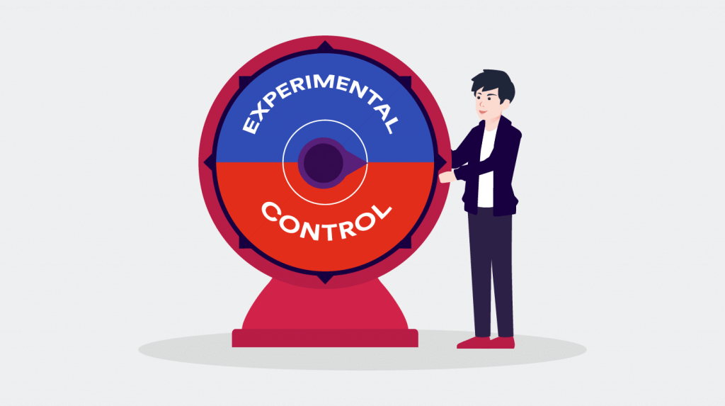
Contributions
Improvements in user attitudes
Transparency =>
Part 1
Transparency
Improvements in
user behaviors
Transparency =>
Design friction is an effective moderation strategy to limit the influence of toxic communities
Effectiveness
Part 2
15
Notes:
Today I am going to talk about some of the contributions on these topics.
First, for transparency in content moderation

Slide 16
Agenda
Background
Transparency
Effectiveness
Future Work
16

Slide 17
Why is transparency important?
Transparency
Platforms should respect human rights (Suzor et al. 2018*)
Freedom of expression
Due process
Due process is hurt by lack of transparency
Users cannot make sense of content takedowns
Difficult to seek remedy
* Nicolas Suzor, Tess Van Geelen, and Sarah Myers West. 2018. Evaluating the legitimacy of platform governance: A review of research and a shared research agenda. International Communication Gazette 80, 4 (2018), 385–400.
Notes:
There is a growing push by scholars and activists for platforms to have a responsibility to respect human rights. This includes providing freedom of expression to users. This also means that platforms should provide due process for the users’ appeals against moderation decisions.
because when there is a lack of transparency, users cannot detect or make sense of content takedowns.
This makes it difficult for users to seek remedy for wrong decisions

Slide 18
Improving Transparency -> Explanations
Transparency
Notes:
One strategy for improving transparency is to provide end users with explanations about why their content was removed.

Slide 19
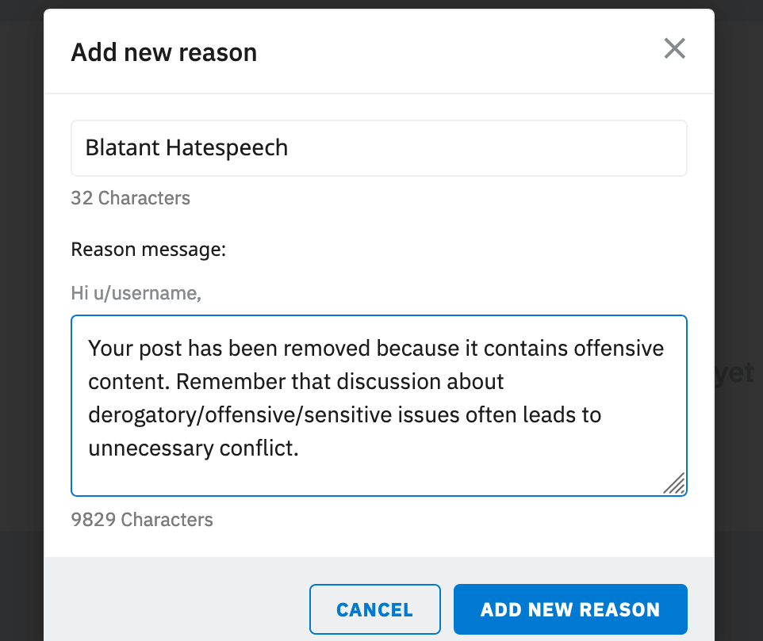
Potential role of explanations
Transparency
Help users learn from mistakes
Cost
Curating explanations
Notes:
Such explanations can play an important role because they can help users
help users understand that if their post is not suitable for a given community, what is the most appropriate community to submit their post
Someone has to spend time curating and delivering these explanations to end-users.
This brings up the question:

Slide 20
Should moderators provide removal explanations?
Transparency
Notes:
Should moderators provide explanations?
And this is the central question I ask in this talk.
Is it worth it for moderators to spend their time and efforts into providing explanation for post removals?
Can such explanations improve user attitudes and behaviors?

Slide 21

Transparency
Notes:
To answer this, I turned to the popular social media platform Reddit

Slide 22

Why Reddit?
Transparency
1000’s of sub-communities
Variety of approaches to content moderation
Rich site to study how differences affect attitudes and behavior
Notes:
I chose Reddit because
Reddit is made up of thousands of communities, and these communities show a variety of approaches to enacting content moderation.
Therefore, the Reddit platform provides a rich site to study how the differences in moderation approaches affect the attitudes and behaviors of users differently.

Slide 23
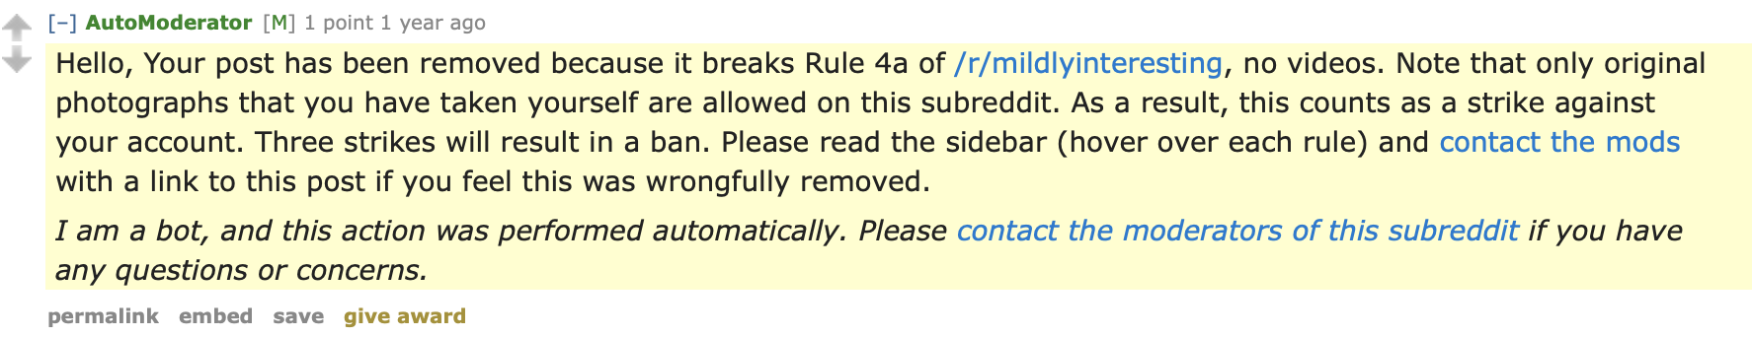
Explanation Comment Example
Transparency
Notes:
This is what an explanation comment on Reddit looks like
This comment was posted as a reply to a submission that was removed.
and it provides user an explanation of exactly why their post was removed.
It warns the user that if they continue to violate rules, their account will be banned.
It also informs the user that if they believe that the removal is mistaken, they con contact the moderators of the subreddit.

Slide 24
Research questions
Transparency
RQ 1: Attitudes
How is providing removal explanations associated with user attitudes?
RQ 2: Behaviors
How is providing removal explanations associated with future behaviors?
Survey
Data mining
Notes:
Given this context, I pose the following research questions.
My first question is about attitudes. I ask,

Slide 25
Transparency: Study 1
RQ 1: Attitudes
How is providing removal explanations associated with user attitudes?
Transparency
“Did you Suspect the Post Would be Removed?”
Understanding User Reactions to Content Removals on Reddit
Shagun Jhaver, Darren Scott Appling, Eric Gilbert, Amy Bruckman
CSCW 2019 (Best Paper Honorable Mention Award)
Notes:
Today I am going to talk about three of the contributions I have made in investigating this overarching research problem
READ BULLETS
ADD CITATIONS IN ALL CONTRIBUTION SLIDES

Slide 26
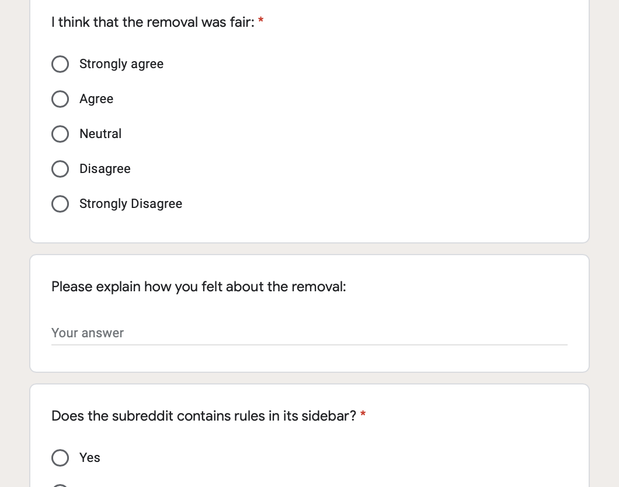
Survey
Transparency: Study 1
907 Reddit users who experienced content removals

Slide 27
Data collection goals
Transparency: Study 1
Submission should be recent
Enough time for moderators to review post
Survey request sent 3-10 hours
after post submission
Notes:
Enough time should have passed for moderators to review post

Slide 28
Transparency: Study 1
Sample recent Reddit posts
PRAW API
Posted within
past 12 hours?
Wait for
3 hours
If yes
…
Check removal status
Automated
data collection
If removed
Invite Poster to Participate

Slide 29
Survey questions
Transparency: Study 1
Multiple Choice Questions
Regression analyses
Open-ended Questions:
e.g., “Please explain how you feel about the post removal”
Inductive analysis

Slide 30
Transparency: Study 1
RQ 1: Attitudes
How is providing removal explanations associated with user attitudes?
Fairness
Posting Again
Perceptions of fairness of post removal
Likelihood of posting again in the future
Q - I think that the removal was fair:
Strongly Agree
Agree
Neutral
Disagree
Strongly Disagree
Q – How likely are you to post again on this subreddit after this experience? :
Very likely
Likely
Neutral
Not likely
Very unlikely
Notes:
I focused on two aspects of user attitudes
that I will refer to as Fairness
I derived information about both of these user attitudes through survey questions

Slide 31
Transparency: Study 1
RQ 1: Attitudes
How is providing removal explanations associated with user attitudes?
Fairness
Posting Again
Perceptions of fairness of post removal
Likelihood of posting again in the future
Dependent Variables
Linear Regression
Notes:
I developed linear regression models to analyze the relationship between different variables, and I used fairness and posting again as my dependent variables

Slide 32
Control variables
Transparency: Study 1
Demographics (collected through survey)
Age
Education
Gender
Prior History (collected using Reddit API)
Reddit karma (popularity metric)
Time on Reddit (in days)
Number of submissions posted on Reddit

Slide 33
Findings
Transparency: Study 1
Notes:
In the interest of time, I will only discuss a sample of insights we gained from our quantitative results, but please check out the paper for more insights.

Slide 34
Transparency: Study 1
Q1: Before you started this survey, did you know that your post was removed?:
Yes
No
Notes:
I want to note here whether or not users are aware of their post removal is an important aspect of transparency in content moderation.
Surprisingly, I found that 41.8% of users did not even know that
In fact, I received dozens of replies to my invitation messages where users expressed surprise about their post removals.

Slide 35
Transparency: Study 1
Awareness of post removal
Fairness
(β = 0.265***)
Posting Again
(Not significant)
❌
***: p < .001
Notes:
My regression analyses show that when users become aware of their post removals, perhaps through communication by the moderation team, they are more likely to consider the moderation of their post as fair than when they are not made aware.
Noticing removals, however, did not have any statistically significant effect on whether participants consider it likely they will post in the future.

Slide 36
Takeaway
Transparency: Study 1
Users care about being notified of post removals

Slide 37
Transparency: Study 1
Q2: Did you receive an explanation for why your post was removed?:
39.7%
Yes
No
60.3%

Slide 38
Transparency: Study 1
Receiving explanation
Fairness
(β = 0.384***)
Posting Again
(β = 0.088*)
*: p < .05 ***: p < .001

Slide 39
Takeaway
Transparency: Study 1
Receiving explanations is linked to improvement in user attitudes

Slide 40
Dissatisfaction about the lack of transparency
Transparency: Study 1
“
The removal is ok, it doesn’t bother me, but it’s not ok that I didn’t get informed. – P838
”

Slide 41
Transparency: Study 1
Q3: The explanation was provided by:
Unsure
29.4%
50.6%
Bot
Human
20%

Slide 42
Transparency: Study 1
Explanation source
Fairness
(Not significant)
Posting Again
(Not significant)
❌
❌
Notes:
My regression analyses show that when users become aware of their post removals, perhaps through communication by the moderation team, they are more likely to consider the moderation of their post as fair than when they are not made aware.
Noticing removals, however, did not have any statistically significant effect on whether participants consider it likely they will post in the future.

Slide 43
Takeaway
Transparency: Study 1
Humans don’t have an advantage over bots in improving user attitudes

Slide 44
Some users self-identify as trolls
Transparency: Study 1
Deliberately violate rules
Receiving removal explanations does not matter
Notes:
My analysis also indicates that some user identify themselves as trolls.
Although these users are aware of the community rules, they deliberately violate those rules.
For example, one of my participants who hated the Patriots football team wrote
This indicates that it may not be worth moderators’ efforts to provide explanations to users who are trolls

Slide 45
Some users self-identify as trolls
Transparency: Study 1
“
I will always post stupid things on the Patriots subreddit until they ban me because I hate the Patriots.
– P579
”
Notes:
Our analyses indicate that some user identify themselves as trolls.
Although these users are aware of the community rules, they deliberately violate those rules.
For example, one of our participants who hated the Patriots football team wrote
This indicates that it may be important to distinguish trolls from other users, and not waste moderation resources on trolls.

Slide 46
Transparency: Study 1
Contributions
Improvements in user attitudes
Transparency =>
Part 1
Transparency
How is transparency associated with improvements in future behaviors?
Notes:
Today I am going to talk about three of the contributions I have made in investigating this overarching research problem
READ BULLETS
ADD CITATIONS IN ALL CONTRIBUTION SLIDES

Slide 47
Transparency: Study 2
RQ 2: Behaviors
How is providing removal explanations associated with future behaviors?
Transparency
“Does Transparency in Moderation Really Matter?”
User Behavior after Content Removal Explanations on Reddit
Shagun Jhaver, Amy Bruckman , Eric Gilbert
CSCW 2019 (Best Paper Award)

Slide 48
Transparency: Study 2
Data preparation
Reddit Corpus
Mar – Oct 2018
80M posts
<user, subreddit> Pairs
4.7M pairs
subsample
For each pair
32 M
submissions
H(user, subreddit)
Post History
Mar – Oct 2018

Slide 49
Transparency: Study 2
RQ 2: Behaviors
How is providing removal explanations associated with user behavior?
H(user, subreddit)
Post History
Mar – Oct 2018
Splitting Post History
Past Posts
Future Posts
H(user, subreddit)_{past}
Mar – June 2018
H(user, subreddit)_{future}
July – Oct 2018
Independent Variables
Dependent Variables

Slide 50
Transparency: Study 2
RQ 2: Behaviors
How is providing removal explanations associated with user behavior?
Future Removal (u, s)
Does user u have a future post in subreddit s that is removed?
Dependent Variable
Logistic Regression
Notes:
I focused on one specific aspect of user behavior.
I tracked for each <u, s> pair, whether the user u has a future submission in subreddit s that is removed, and I call this variable Future Removal. Now this is a binary variable, so I built logistic regression models to analyze the relationships between different independent variables and Future Removal, which I considered to be my DV.
proxy

Slide 51
Control variables
Transparency: Study 2
Subreddit Variables
# Subreddit Subscribers
# Subreddit Submissions
Net Subreddit Removal Rate
Post History Variables
Past Submissions by user u in subreddit s
Avg. Past Score
Avg. Past Comments
Notes:
These variables are indicative of the size, activity level, and moderation rate of each Reddit community. I control for these variables because I suspected that they are likely to have an effect on user activity.

Slide 52
Findings
Transparency: Study 2

Slide 53
Transparency: Study 2
Explanation rate
Proportion of removed posts that received explanations
Explanation rate
Future Removals
(6.5% lower odds***)
Nagelkerke R Square = 0.187
***: p < .001

Slide 54
Takeaway
Transparency: Study 2
Explanations are linked to
improved user behaviors

Slide 55
Transparency: Study 2
Explanation by bot rate
Proportion of explanations that are provided by bots
Explanation by
bot rate
Future Removals
(Not significant)
❌
Nagelkerke R Square = 0.231

Slide 56
Takeaway
Transparency: Study 2
Humans don’t have an advantage over bots in improving user behaviors

Slide 57
Transparency: Study 1&2
Contributions
Improvements in user attitudes
Transparency =>
Part 1
Transparency
Improvements in
user behaviors
Transparency =>
57
Notes:
Today I am going to talk about three of the contributions I have made in investigating this overarching research problem
READ BULLETS
ADD CITATIONS IN ALL CONTRIBUTION SLIDES

Slide 58
Transparency: Study 1&2
Implications
Theoretical, Design, and Policy
58
Notes:
I would like to discuss some theoretical, design, and ethical implications.

Slide 59
Implications
Transparency: Study 1&2
Transparency is a key concern for moderated users
Users care about being notified of post removals
Users care about receiving explanation for post removals

Slide 60

Implications
Transparency: Study 1&2
Human mods have no advantage over bots for improving user attitudes or user behaviors
Opportunity for deploying tools for explanation
Explainable AI

Slide 61
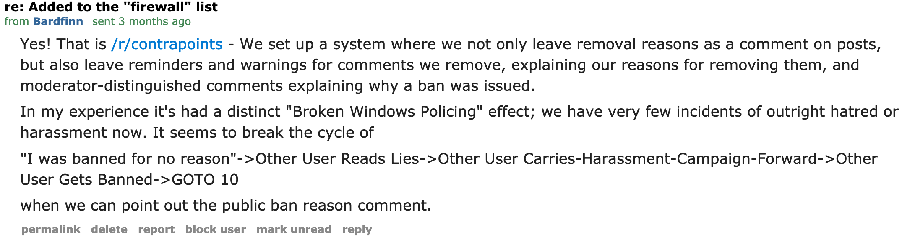
Implications
Transparency: Study 1&2
Direct Impact on Communities
Moderators began offering removal explanations
r/contrapoints subsequently reduced hatred
Notes:
contrapoints, a subreddit with 70,000 subscribers began

Slide 62

Implications
Transparency: Study 1&2
Moderation should shift from a punitive model to an educational model
Notes:
This research also suggests a need for paradigm shift in content moderation
Platforms should work with community members, educating them about the community norms and turning them into valuable contributors

Slide 63

Implications
Transparency: Study 1&2
Collaboration with Twitch
Notes:
This work also directly resulted in a collaboratiion with Twitch, a gaming-focused social network. I am currently working as a contractor with Twitch in order to help them incorporate transparency in content moderation for their millions of viewers.

Slide 64
Transparency: Study 1&2
Attitudes
Removal Explanations
Behaviors
Example of
Mixed-methods Analyses
z
Insights into social needs
Improve behaviors
Notes:
So in this work, I have focused on one design choice, the provision of removal explanations, and discussed how it relates to user attitudes and behaviors. But this provides a concrete example of how my mixed-methods analysis approach can help us obtain nuanced insights into
And going forward, I want to continue using such mixed-methods approaches to inform the design of online communities.

Slide 65
Agenda
Background
Transparency
Effectiveness
Future Work
65

Slide 66
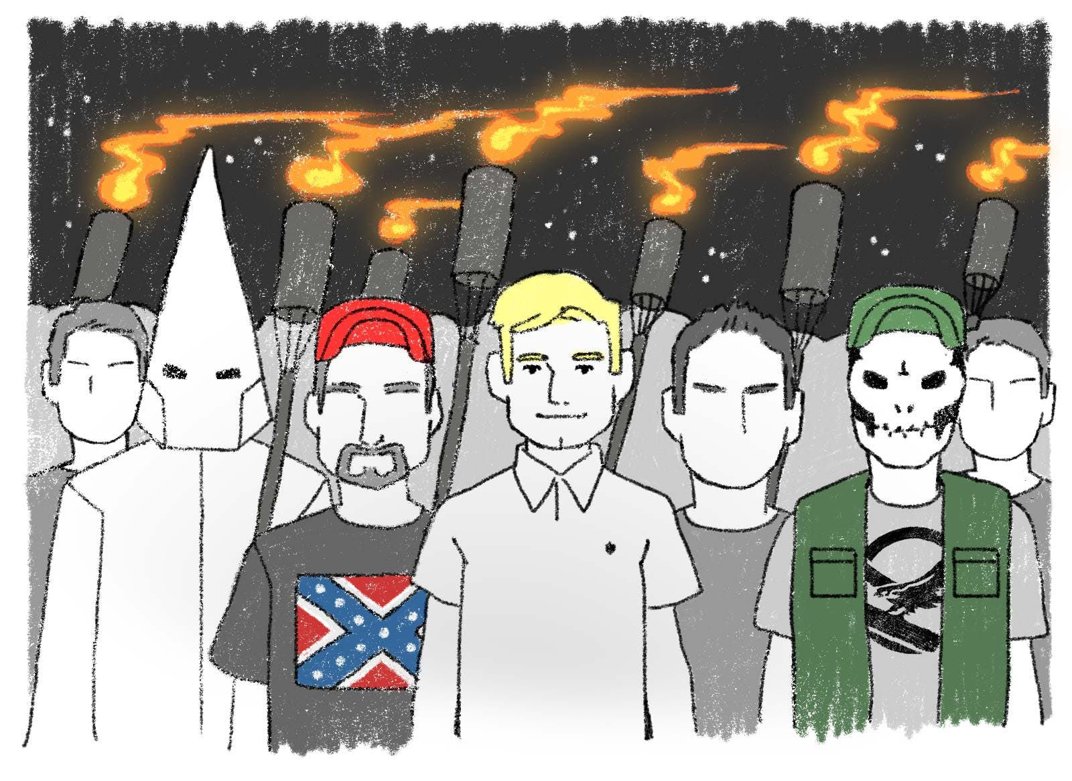
Effectiveness of Moderation Interventions
Effectiveness
Effectiveness in addressing the rise of online hate groups
Radicalization of new individuals
Platforms use a variety of approaches
RQ: How can we evaluate the effectiveness of moderation approaches?

Slide 67
Effectiveness
Moderation sanctions
User-level
Community-level

Slide 68
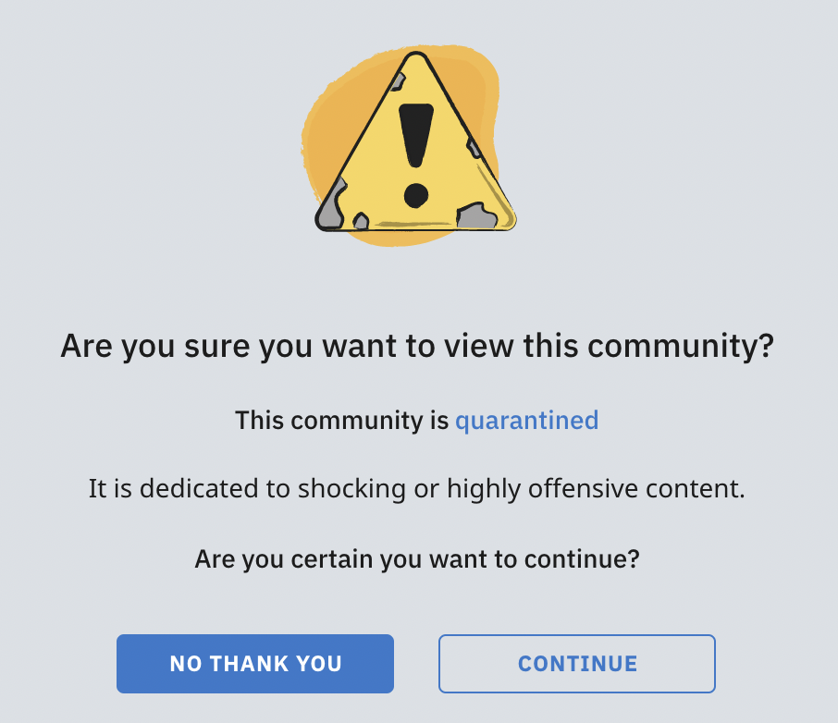
Quarantining: A community-level sanction
Effectiveness
Visitors need to explicitly opt-in to view
Protects freedom of speech
Serves as a warning before the ban
Design friction:
Intentionally adding points of difficulty during users’ interaction with technology
Design friction as a moderation strategy

Slide 69
Effectiveness: Study 1
RQ: New User Influx
How does quarantining affect the influx of new users?
Effectiveness
Quarantined! Examining the Effects of a Community-wide Moderation Intervention on Reddit
Shagun Jhaver, Eshwar Chandrasekharan, Amy Bruckman,
Eric Gilbert (Under review at CSCW)
69

Slide 70
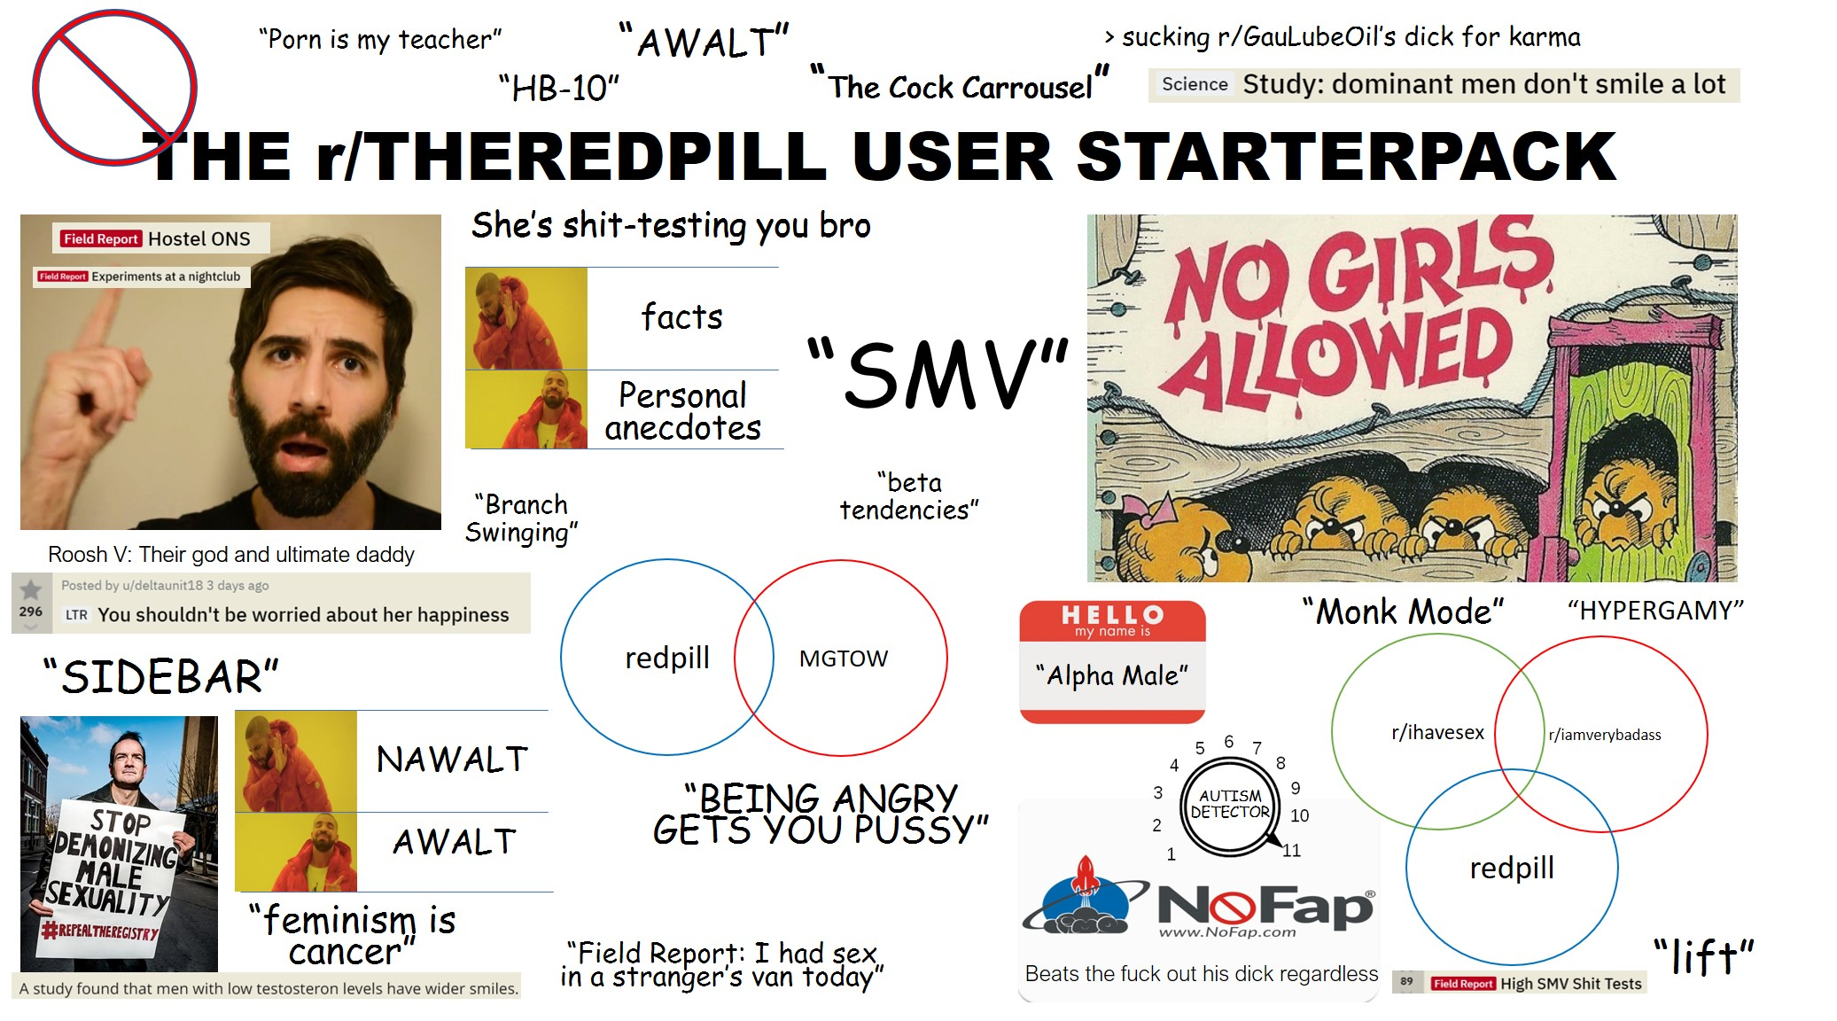
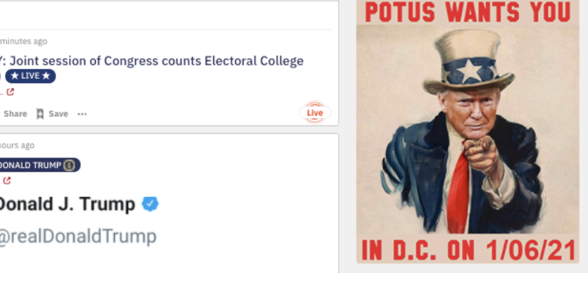
Two largest quarantined subreddits
Effectiveness: Study 1
r/TheRedPill
Misogyny
Anti-feminist discourse
250K subscribers
r/The_Donald
Racism
Far-right discourse
750K subscribers

Slide 71
Effectiveness: Study 1
Data preparation
r/TheRedPill
r/The_Donald
100 control subreddits
100 control subreddits
For each subreddit
85 M
Reddit Posts
Collect posts six months before to six months after quarantine
Daily influx of new users

Slide 72
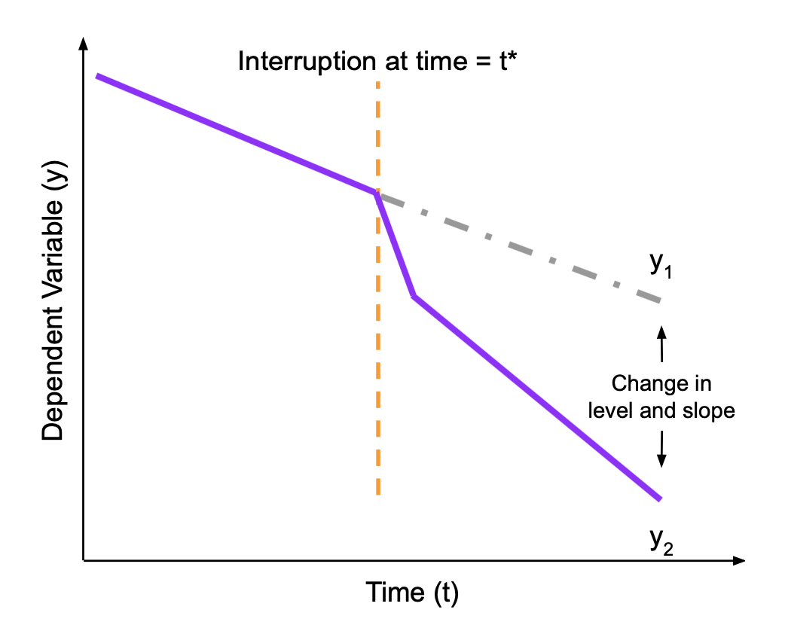
Methods
Effectiveness: Study 1
Interrupted Time-series (ITS) Analysis
Accounts for ongoing temporal trends within quarantined subreddits
Bootstrapping Test
Multiple simulations to compute β distribution for control subreddits
Examine whether β(TheRedPill) or β(The_Donald) is extreme in related to control distribution

Slide 73
Findings
Effectiveness: Study 1

Slide 74
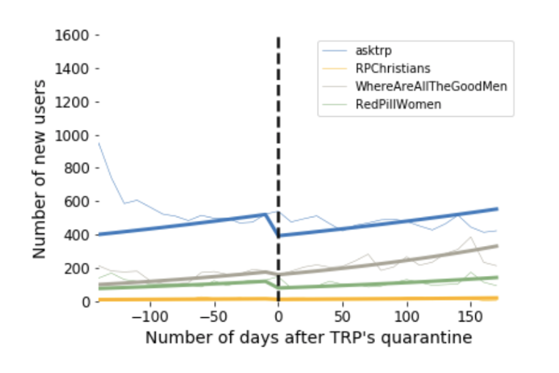
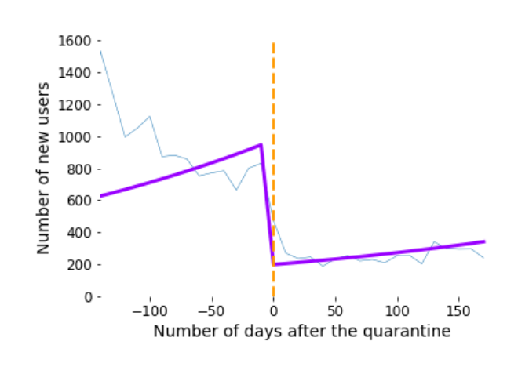
Sharp decrease in the influx of new users
Effectiveness: Study 1
r/TheRedPill
Control subreddits

Slide 75
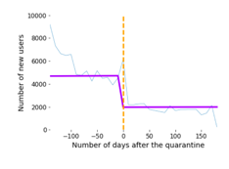
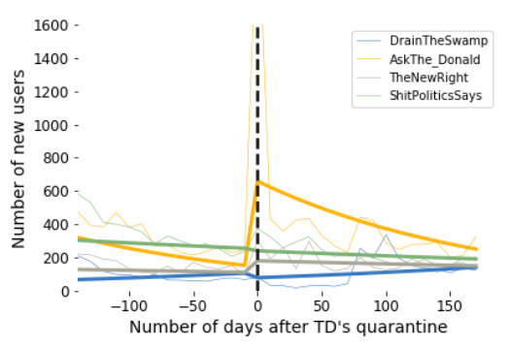
Sharp decrease in the influx of new users
Effectiveness: Study 1
r/The_Donald
Control subreddits

Slide 76
Sharp decrease in the influx of new users
Effectiveness: Study 1
ITS analysis:
r/TheRedPill: β = -1.58***
r/The_Donald: β = -.8732***
Bootstrapping analysis:
Significant drops in both r/TheRedPill and r/The_Donald
***: p < .001
Notes:
The final results of my ITS analyses also

Slide 77
Implications
Effectiveness: Study 1
Design friction as a moderation strategy
Effective compromise between censoring offensive speech and preserving freedom of expression.

Slide 78
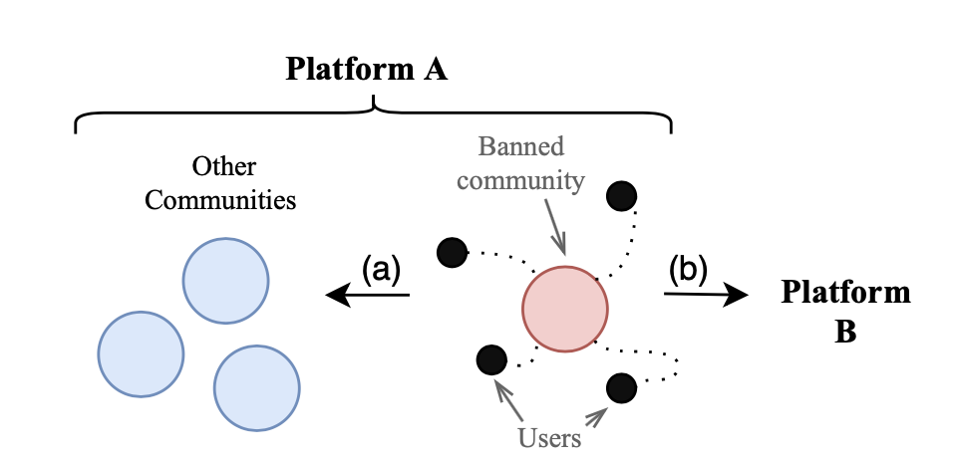
Migration to other online spaces
Effectiveness: Study 2
Manoel Horta Ribeiro, Shagun Jhaver, Savvas Zannettou, Jeremy Blackburn, Emiliano De Cristofaro, Gianluca Stringhini, and Robert West. “Does Platform Migration Compromise Content Moderation? Evidence from r/The_Donald and r/Incels.” Under Review at International World Wide Web Conference (WWW).

Slide 79
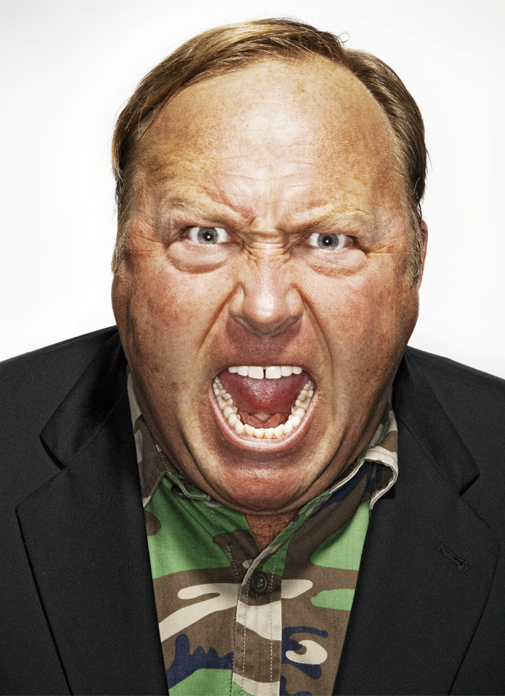
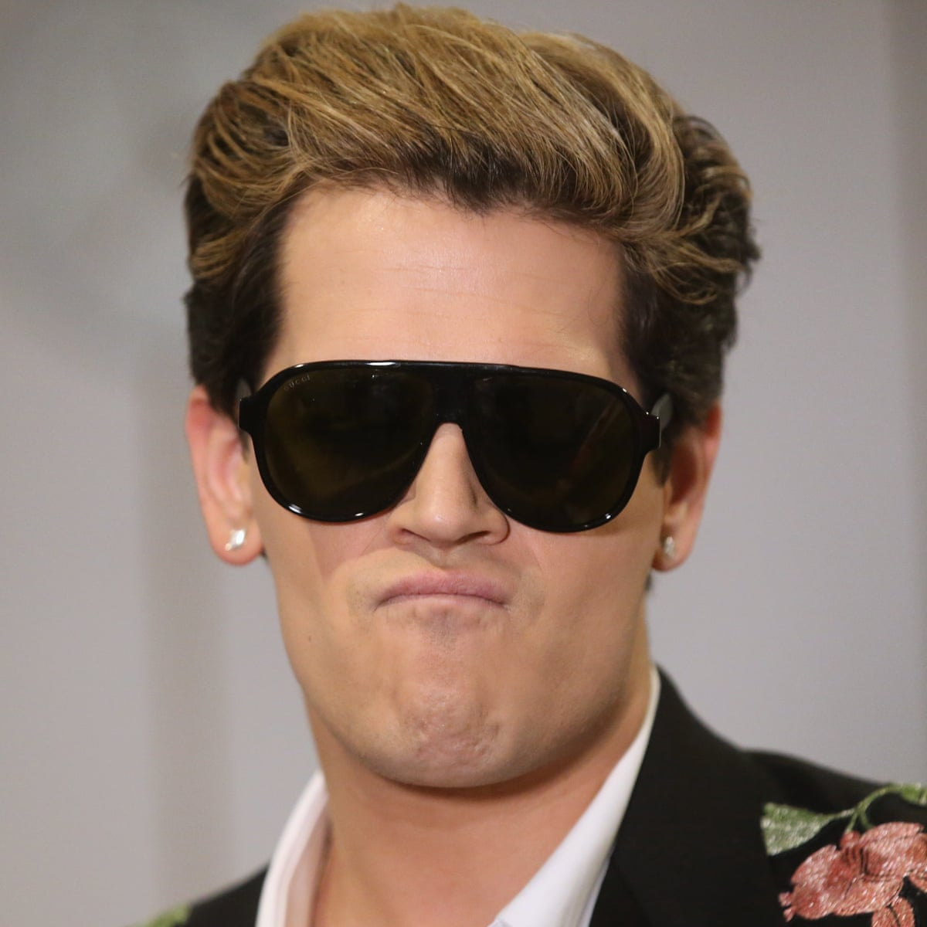
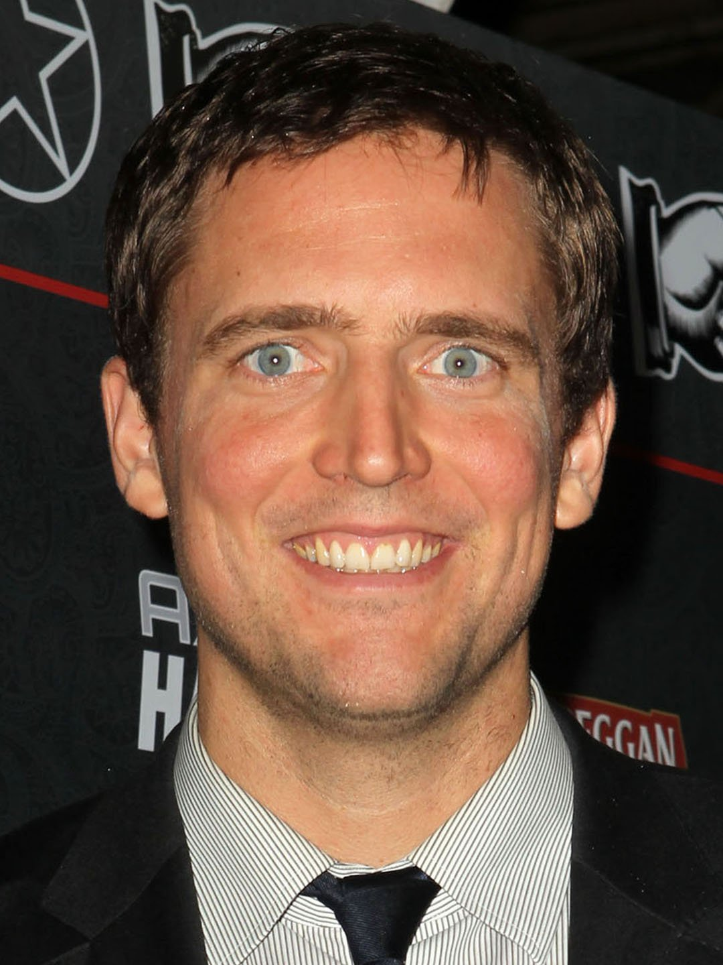
Deplatforming on Twitter
Effectiveness: Study 3
Alex Jones
Milo Yiannopoulus
Owen Benjamin
Shagun Jhaver, Christian Boylston, Diyi Yang, and Amy Bruckman. “Evaluating the Effectiveness of Deplatforming as a Moderation Strategy on Twitter.” Under Review at Proceedings of the ACM Human-Computer Interaction (CSCW).

Slide 80
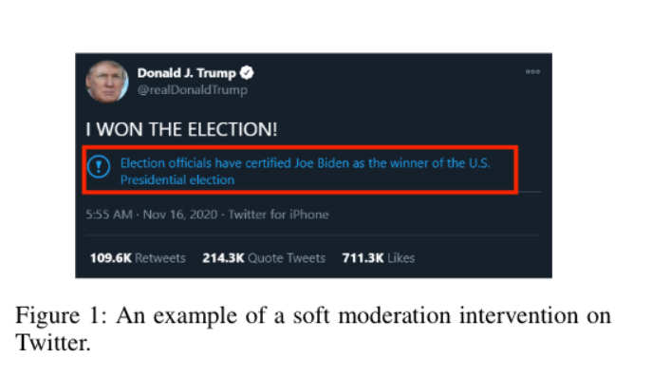
Warning Labels
Effectiveness: Study 4
Shagun Jhaver, Savvas Zannettou, Oana Goga and Krishna Gummadi. “Examining the Effects of Warning Labels on Twitter.” In Progress.

Slide 81
Implications
Effectiveness: Study 1-4
Frameworks to evaluate the effectiveness of moderation strategies

Slide 82
Contributions
Improvements in user attitudes
Transparency =>
Part 1
Transparency
Improvements in
user behaviors
Transparency =>
Design friction is an effective moderation strategy to limit the influence of toxic communities
Effectiveness
Part 2
82
Notes:
Today I am going to talk about some of the contributions on these topics.
First, for transparency in content moderation

Slide 83


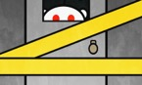





Research Overview
Content Moderation
Transparency
Evaluating Moderation Interventions
User attitudes
User behavior
Transparency
Quarantining
Deplatforming
Migrations
Online Harassment
Enacting Content Moderation
Defining
Current moderation
Restorative Justice
Human-m/c collaboration
Blocklists
Federalism
83
Notes:
I have defiend online harassment and identified different tadctics of online harassment
I have also studied how we can use restorative justice framework to address online harassment.
This framework has been used offline to rehabilitiate prison populations and I have explored how we can implement this framework on social media sites to rehabilitate offenders as well as support victims of online harassment.
Moderation on many social platforms have a lot in common with the US government works. So I am exploring what we can learn from theories of offline governance like federalism and polycentricity to improve content moderation

Slide 84






Content moderation
Fairness &
Transparency
Evaluating
Moderation
Online
Harassment
Enacting
Moderation
Future of work
Skill
Searches
Control &
Uncertainty
Learning
to Airbnb
Automod
Sharing economy
Platform communications
Algorithmic
Evaluation
Work
Practices
Chat
Delays
Moderators’ Activity
Social movements
Argumentation
Black lives matter
Kotaku in Action
Men’s rights
Reddit norms
Change my view
Notes:
Let me briefly point out some of my research interests other than content moderation.
I am interested in sharing economy platforms like Airbnb. For example, I have studied how the use of algorithms to evaluate workers on Airbnb affect their work practices. I have also explored how Airbnb hosts use social media to connect with one another and learn how to be more productive.
I have explored how people use search engines to learn new skills. I have also characterized how differences in internet-based skill development behaviors across different parts of the US contributes to growing economic disparities.
Finally, I have studied how social media facilitates a wide variety of social movements – movements ranging from Black Lives Matter, GamerGate and Men’s rights movement.

Slide 85
Agenda
Background
Transparency
Effectiveness
Future Work
85

Slide 86
Incorporating ethical principles in designing platform communications
Future Work
How can we incorporate fairness & transparency when:
Users flag inappropriate content
Users appeal against moderation decisions
How does algorithmic content curation affect workers?
Uber Eats: restaurant owners’ mental models of search results
Transparency, consistency, competency
How are users’ perspective affected by platform policies?
Prominence
Clarity
Comprehensibility

Slide 87
Combating online radicalization and the rise of hate groups
Future Work
Glorification and trivialization of violence
Visual or textual means that are ambiguous
Memes and visual cultures target outgroups like ethnic minorities, women, and the LGBTQ community
Identify sources of violent narratives
Chan cultures
Textual and Visual analysis
NLP methods, image comparison algorithms (e.g., DBSCAN), and digital ethnography

Slide 88
Building human-centered AI tools to address online harassment
Future Work
Human-AI hybrid tools to empower users to address online harassment
Tools for YouTube creators to configure regular expressions for blocking inappropriate comments
Machine learning models to create categories of offensive content
Configure automated actions for each category
Share models and build on top of others’ work
Adapt the techniques to address a wider variety of problems in online social systems
Human-m/c collaboration tools that improve the efficacy of volunteer moderation work

Slide 89

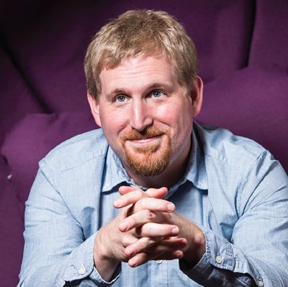

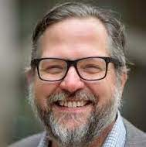










































89
Notes:
these are some of the lovely people from across academic institutions and industry that I have worked with on my research projects
I am excited to extend this network at George Mason.

Slide 90
Designing Transparent and Effective Content Moderation
Shagun Jhaver

